Slide 1
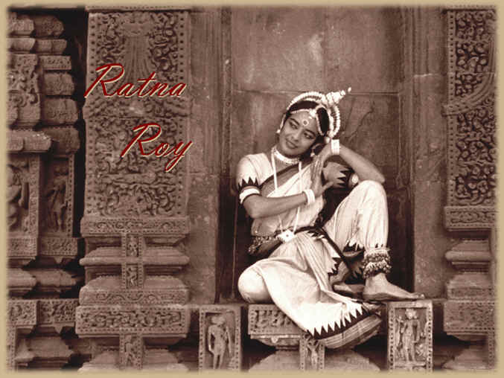
Widows, Dowry Death and Honor Killings: An Indian Case Study

Slide 2
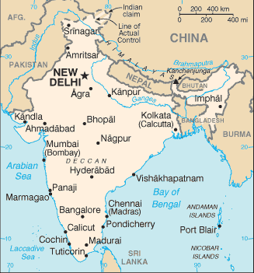
India
Becoming a major American workforce due to widespread English speaking
  Are software workers and customer service agents
One billion people
High sex-ratios
Society operates and is built upon a Caste system that hierarchically separates people
Notes:
attitudes of superiority, pollution and separateness

Slide 3

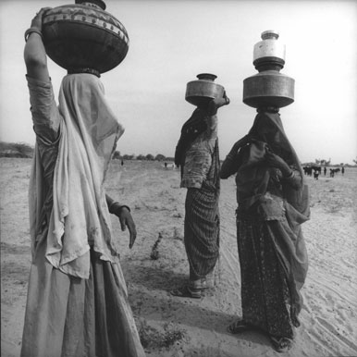
Women’s rights
Women viewed as property with no rights
Women have little economic or political power
Not able to remarry
Literacy
  male: 70.2%
  female: 48.3%
The main access to resources is through mate competition –
  so they give up more of what males want –chastity, paternity certainty, sexual control, resource control, political voice

Slide 4
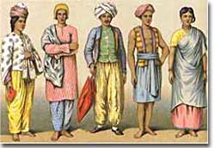
Caste Society
1 in 25 people in the world are discriminated within a Caste system
Born, marry and die within your caste – little social mobility
The Caste system is
  Ancient
  highly complicated
  probably emerged with increases in population and specialization of labor
Intercaste marriages are more rare but not unheard of for women to move up
Determines nearly all aspects of life:
  Friends, jobs, what you eat, marriages, economic assess to resources, discrimination (economic, personal and criminal), type of education
Notes:
e.g. someone who accepts food and water from another person but the other person does not reciprocate the same way, then the other person is superior to the former

Slide 5
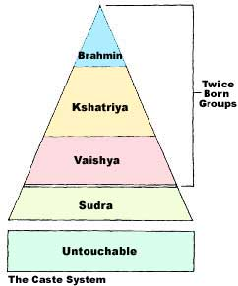
India Caste Society
Within each varna are several sub-groups or jats (thousands exist)
These jats are also hierarchically arranged and some confusion and conflict exists over superiority
The Hindu caste system is ordered hierarchically, with Brahmins at the top and Sudras at the bottom. Untouchables, also known as Harijans or Dalits, fall outside of the caste system all together
Notes:
'In the rainy season,' the woman began, `it is really bad. Water mixes with the shit and when we carry it (on our heads) it drips from the baskets, on to our clothes, our bodies, our faces. When I return home I find it difficult to eat food sometimes. The smell never gets out of my clothes, my hair. But this is our fate. To feed my children I have no option but to do this work.'
Narayanamma began cleaning human excrement at 13. She is now 35. The stench is nauseating, overpowering. First, she sweeps the shit into piles. Then, using two flat pieces of tin, she scoops it up and drops it into a bamboo basket which she carries to a spot where a tractor will arrive to pick it up. No gloves. No water to wash with. She hitches up her sari tightly so that it does not trail on the ground or touch the shit. Still, it is almost impossible to go through a whole day's work without some of it inadvertently getting onto her clothes and person.
After 20-odd years of cleaning toilets. Narayanamma clings to a dignity which is markedly at variance with the work she does. She is dressed neatly, immaculately clean. Jasmine adorns her oiled and well groomed hair.
Narayanamma and 800,000 other toilet cleaners are on the lowest rung of the caste system in India. They are despised by everyone. They experience absolute exclusion from the cradle to the grave.
Discrimination in Detail
In India, Brahmins, who are 3.5 per cent of the population, hold 78 per cent of the judicial positions and approximately 50 per cent of parliamentary seats.
Mass rapes often form part of the tactics of intimidation used by upper-caste gangs against lower castes. The Home Ministry reported that, between 2000 and 2001, there was a 16.5 per cent increase in reported rape cases.
Each year, inter-caste violence claims hundreds of lives; in 2001 it was especially pronounced in Uttar Pradesh, Bihar, Rajasthan, Madhya Pradesh, Tamil Nadu, and Andhra Pradesh.
In India, among the millions of bonded labourers (estimates range widely between 20 to 65 million for 2001), the Government found 85 per cent to be Dalits or from lower castes. These included a large number of children.
Dalits and adivasis (indigenous peoples) form the largest proportion of those who drop out of school. In rural areas, between the ages of five and nine, 36.1 per cent of Dalit boys and 48.4 per cent of Dalit girls dropped out.
About 75 per cent of Dalit communities live below the poverty line.
Two-thirds of the Dalit population is illiterate.
Half are landless agricultural labourers.
Only seven per cent have access to safe drinking water, electricity and toilets
Brahmins (Teachers, Scholars and Priests), The Khshatriyas (Kings and warriors), the Vaishyas (Traders, Landowners and some Artisan groups), and Shudras (Agriculturists, Service providers, and some Artisan groups)
Origins: Caste was probably job based, but then became rigid and inherited

Slide 6
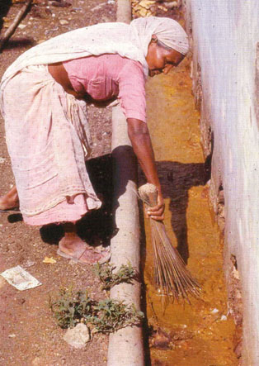
Caste Society and Women
Women may face strict punishment for adultery
Rape –particularly of the lower castes is not uncommon by higher caste males, military or police
Thousands of women are forced into prostitution by husbands in the lower castes
Lower caste people are often harassed by upper castes for not behaving according to their caste
Notes:
Unlike the varna system of Brahmins, which requires spiritual purity in order to ascend, a jāti is able to move up or down the social hierarchy based on the aspirations of its members. Marriages are usually arranged within one's own sub-caste; however, they may occur between two affiliated sub-castes, or two sub-castes that are in the same region, and are as such termed intercaste marriages. Over time, this grew more and more rigid, until every aspect was determined by birth, with various "justifications" as described below.

Slide 7
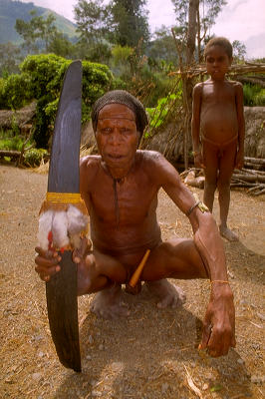
Definitions
Bride Price – fortune, goods, or services the male gives to the female’s family
Dowry – fortune, goods or services the female provides to the male and his family (more common in stratified society)
  In India, dowry is often seen as a bribe to the son-in-law to take a daughter-of-age off their hands

Slide 8
Expectations about Marriage
Complex Wage and Marriage Markets with Equal Access
Reproduction
Care of children
Sexual exclusivity
Economic cooperation
romantic love
companionship
joint recreational activities
emotional support
career support
common social circle
All Societies
Reproduction
Care of children
Sexual exclusivity
Economic cooperation

Slide 9
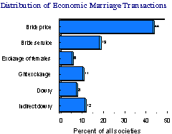
Cultural Ecology and Dowry
80% of societies are patrilocal
Evidence indicates that in societies where women heavily engage in primary production – get bride wealth

Slide 10
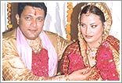
Locations of dowry giving
Stratified societies
Very common in India (but illegal)
Was very common England until 19th century
Ancient Hebrew tribes and some Arab tribes
Rural China and other parts of Asia
At times in Egypt history
Ancient Greece (Athens)
Ancient Rome

Slide 11
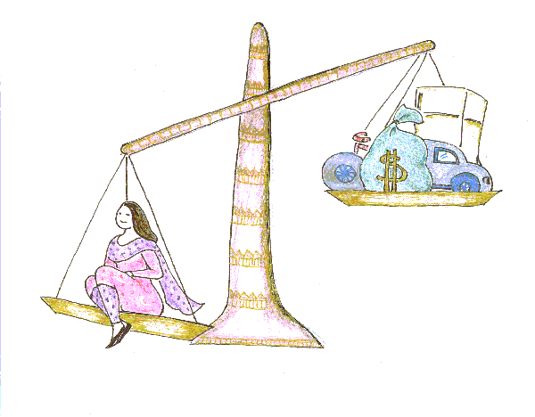
India: Current state of affairs with dowries
Is illegal in India – but persists
Money/goods paid to groom’s family
Gifts include: washing machines, fridges, cars, apartments, money
Substantial dowries often needed
Exacerbated by inflation & increase in consumerism
Amount is agreed upon, but sometimes the grooms family demands more

Slide 12
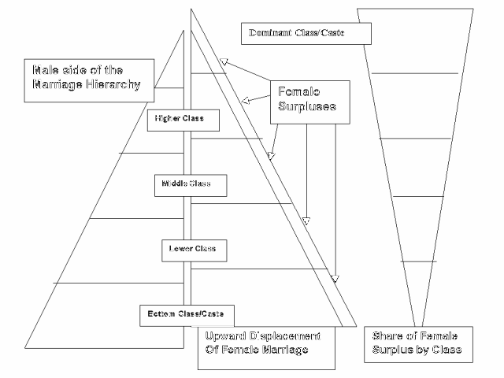
Competition for Mates Increases Amounts of Dowry

Slide 13
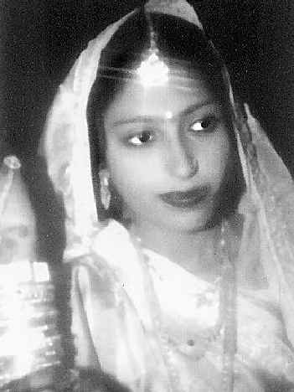
Presence of Dowry Violence
Studies indicate that 90% of dowry deaths and 80% of dowry harassment occur in the middle and lower strata
This increase may be due to emerging consumer society that is mixed with a highly stratified caste system in which women have far less political and economic power

Slide 14
Violence associated with Dowry
Rape & beating
Acid throwing
Sex selective abortion
Female infanticide
Forced suicide
Homicide (as bride burring)

Slide 15
Violence against Spouses: Cross-cultural Data
Wife beating as a function of cultural variation is more frequent:
  men control products of family labor
  men have final say in domestic issues
  widow remarriage is controlled by husband’s kin
  lack of female work groups
R. Hames via Levinson

Slide 16
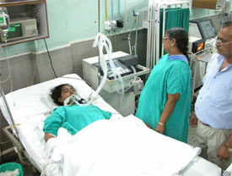
Dowry death: India
Marital violence occurs after initial giving of dowry
Family makes additional demands
By harassing the bride who always lives with the grooms family (patrilocal)
Series of events may culminate in her murder
Usually by burning her to death

Slide 17
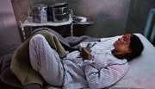
Extortion Techniques
Young wives at mercy of husband and groom’s family
My be Threatened, Beaten, Starved, Jailed in the house
Dousing with kerosene or paraffin and set ablaze claiming kitchen mishap
Sons are able to remarry
Recovering from Acid thrown on her face

Slide 18
Dowry Death Statistics
In Delhi it is estimated that a woman is burned to death every 12 hours
In 1988-2,209 women died from dowry related incidents
In 1993 – 5,377 1998 – 12,612
Some estimates now as high as 25k/yr
Studies between hospitals and police reports indicate a great many incidents go unreported to police
Many thousands more maimed and scarred
A DowryDeath reported in India papers nearly every day
More common in Northern region, because in the South –women engage in agriculture so have economic role

Slide 19
New Dehli
Incidence of Female Suicides Cause: Dowry Dispute
Year
1990
1991
1992
1993
1994
No. of Suicides
1298
1310
1370
1486
1613
Incidence of Crimes Against Women by Crime Head 1990-94
Crime Head
1990
1991
1992
1993
1994
Torture
13450
15949
19750
22064
25946
Dowry Deaths
Year
1990
1991
1992
1993
1994
1995
1996
1997
No. of Deaths
4836
5157
34962
5817
4935
5092
5513
6006
Source: Women in India: a statistical profile - 1997. New Delhi: Department of Women and Child Development, Ministry of Human Resource Development, Government of India, 1997.

Slide 20
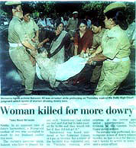
Times of India
A 25-year od woman was allegedly burnt to death by her husband and mother-in-law at their East Delhi home yesterday. The housewife, Mrs. Sunita, stated before her death at the Jaya Prakash Narayana Hospital that members of her husband’s family had been harassing her for bringing inadequate dowry.
The woman told the Shahdara subdivisional magistrate that during a quarrel over dowry at their Pratap Park house yester, her husband gripped her from behind while the mother-in-law poured kerosene over her clothes.
Her clothes were then set ablaze. The police have registered a case against the victim’s husband, Suraj Prakash, and his mother.”
----Times of India, February 19, 1988

Slide 21
Times of India
May 27: Young housewife burnt alive for dowry
LUCKNOW: For nineteen-year-old Rinki dreams of a happily married life was never to be. Barely a month after her marriage, she was allegedly tortured and then set ablaze by her in-laws for dowry in Indiranagar in the small hours of Saturday. Daughter of late Gyan Chand, a fish contractor who expired a year ago, Rinki was married to Anil on April 19... However, soon after the marriage, Balakram [Anil’s father] demanded a colour television instead of a black and white one and a motorcycle as well. When Rinki’s mother failed to meet their demands, the teenage housewife was subjected to severe physical torture, allegedly by her husband and mother-in-law... On Saturday morning she [her mother] was informed that Rinki was charred to death when a kerosene lamp accidentally fell on her and her clothes caught fire. However, prima-facie it appeared that the victim was first attacked as her teeth were found broken. Injuries were also apparent on her wrist and chest.

Slide 22
Times of India
June 7: Woman ends life due to dowry harassment
HAVERI: Dowry harassment claimed yet another life here recently. Jyoti, daughter of Chandrashekhar Byadagi, married to Ajjappa Siddappa Kaginelle in Guttal village (Haveri taluk) had taken her life after being allegedly harassed by her husband Ajjappa, mother-in-law Kotravva, sister-in-law Nagavva and father-in-law Siddappa for more dowry, the police said. Police said that the harassment compelled her to consume poison... The Guttal police have arrested her husband and father-in-law.

Slide 23
Times of India
June 7: Body found floating
HAVERI: The police said that a woman’s body was found floating in a well at Tilawalli (Hanagal taluk) near here... The deceased has been identified as Akhilabanu Yadawad (26). The police said that Akhilabanu was married to Abdul Razaksab Yadawad five years ago. In spite of dowry being given, her husband and his family tortured her to bring some more dowry. Her father, Abdulrope Pyati in his complaint, alleged that she was killed by them. Her husband and his two brothers have been arrested, the police added

Slide 24
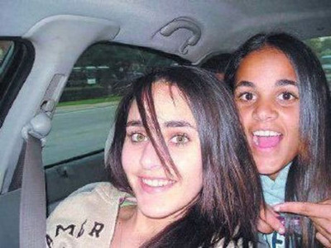
Ayear after the tragic death of two daughters found dead in the back seat of their father's taxi cab, the FBI is now for the first time labeling this an "honor killing." The two daughters were brutally killed on New Year's Day leading to questions about whether their father — the prime suspect and the subject of a nationwide manhunt — may have targeted them because of a perceived slight upon his honor.

Slide 25
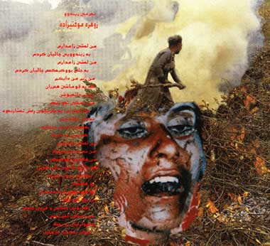
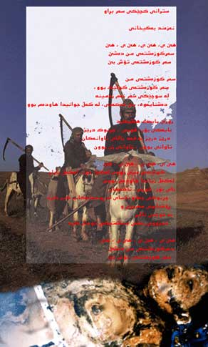
Honor Killings as punishment technique to enforce chastity

Slide 26
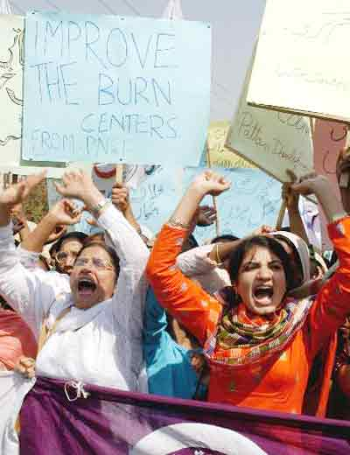
Honor Killings
UNICEF defines Honor killing as an ancient practice in which men kill female relatives in the name of family 'honor' for forced or suspected sexual activity outside marriage, even when they have been victims of rape.

Slide 27
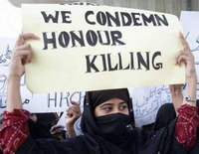
Origins
Has its origins in ancient tribes which look upon a girl’s chastity as family property
It is a means of controlling reproductive, marital and behavioral rights of women

Slide 28
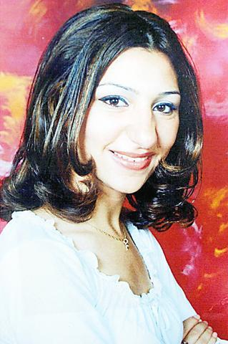
Statistics
Nearly impossible to know how many, but estimates are:
  Pakistan 1000/yr
  Yemen 400/yr
  Egypt 50/yr
  Lebanon 36/yr
  Gaza 2/3’s of all homicides
  Saudi Arabia?
  Jordan?
  India?
  Turkey?
  Taipei?
Killings are shrouded in secrecy from the police and law enforcement by the families and the community making it particularly difficult to prosecute or uphold laws
Heshu Yones, a muslim teenager who was hacked to death in an 'honor killing' by her father.
PHOTO: AP
Taipei Times

Slide 29
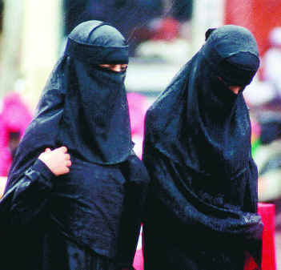
What Prompts Killings?
Marrying outside caste, community or religion
Being Raped
Unwed pregnancy
Infidelity or flirting
Widows trying to remarry
Men may also killed for marrying outside caste – and his wealth is distributed among rest of the family

Slide 30
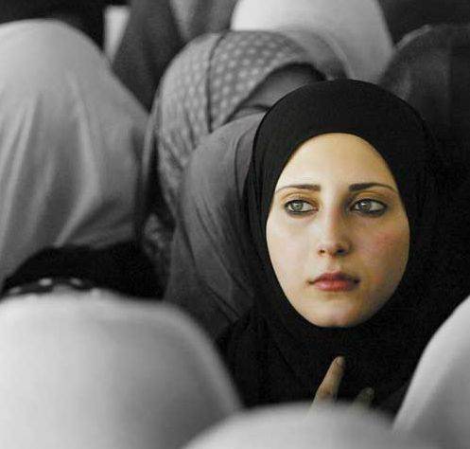
Characteristics of Honor Killings
See it as religious interpretation of the Koran –but predates Islam
Typical crimes: “misbehaviors” or “rumors” of impropriety with men
Shame is believed to be brought to family by her
Murders are exceptionally brutal
Surrounding community almost always supportive & protestors are “silenced”
Perpetrators usually have lighter sentences

Slide 31
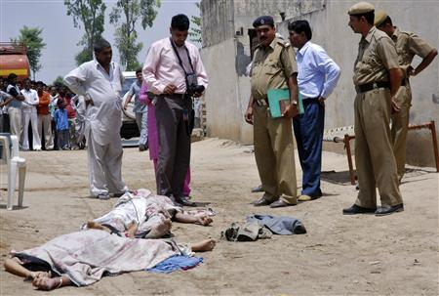
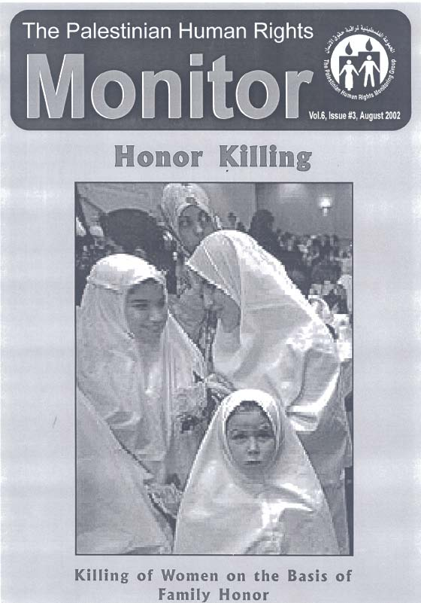
Conflicting Laws
Law Example Pakistan: a rape victim has to produce 4 witnesses in court to testify that they saw her being assaulted, otherwise she can be tried on charges of willful adultery while the rapist goes free
Notes:
Police look at the bodies of Sunita Devi (bottom L), 21, and
her partner Jasbir Singh, 22, after they were killed by villagers in an
“honour killing” in Ballah village in the northern Indian state of Haryana
May 9, 2008. Image: Reuters stringer
BALLA, India (Reuters) – Five armed men burst into the small room and courtyard at dawn, just as 21-year-old, 22-week pregnant, Sunita was drying her face on a towel.
They punched and kicked her stomach as she called out for her sleeping boyfriend “Jassa”, 22-year-old Jasbir Singh, witnesses said. When he woke, both were dragged into waiting cars, driven away and strangled.
Their bodies, half-stripped, were laid out on the dirt outside Sunita’s father’s house for all to see, a sign that the family’s “honor” had been restored by her cold-blooded murder. . .

Slide 32
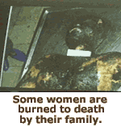
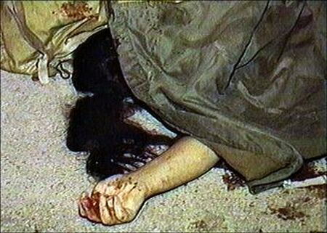
The Brutality of Honor Violence and Murder:
Women being repeatedly raped by upper caste men if she marries outside of the caste
Many are beaten about the face, but others have pieces of their face cut off
Some made to eat excrement and drink urine
Public lynchings and social boycotts
Some have hands and feet cut off
Throats cut, Head bashings, shootings
Not considered “Murder” by the families

Slide 33
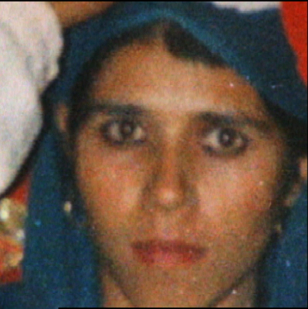
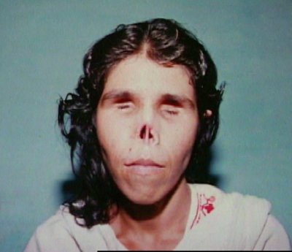
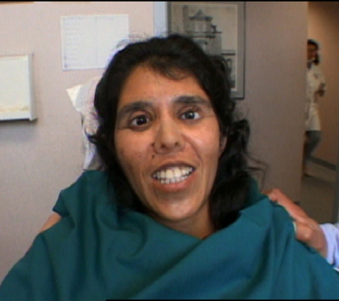
Photos Attempted Honor Killing
Before: 6mo pregnant
After: husband cut off her ears, tongue, and nose, gouged out her eyes, and left her for dead for suspected infidelity
National Geographic
reconstructive surgery in the United States. She received a prosthetic nose and ears and artificial eyes

Slide 34
Story
Rofayda Qaoud - raped by her brothers and impregnated - refused to commit suicide, her mother recalls, even after she bought the unwed teenager a razor with which to slit her wrists. So Amira Abu Hanhan Qaoud says she did what she believes any good Palestinian parent would: restored her family's "honor" through murder.
Armed with a plastic bag, razor and wooden stick, Qaoud entered her sleeping daughter's room last Jan. 27. "Tonight you die, Rofayda," she told the girl, before wrapping the bag tightly around her head. Next, Qaoud sliced Rofayda's wrists, ignoring her muffled pleas of "No, mother, no!" After her daughter went limp, Qaoud struck her in the head with the stick.
Killing her sixth-born child took 20 minutes, Qaoud tells a visitor through a stream of tears and cigarettes that she smokes in rapid succession. "She killed me before I killed her," says the 43-year-old mother of nine. "I had to protect my children. This is the only way I could protect my family's honor."

Slide 35


Jordan woman killed
Refused an arranged marriage to a cousin
Was shot 5 times by her brothers

Slide 36
Amnesty Story
Lahore, Pakistan:
6 April 1999, 29-year-old Samia Sarwar, the mother of two young boys, was shot dead in the office of her lawyer. Samia was seeking a divorce after suffering years of domestic abuse from her violent husband. Her family felt that in seeking divorce, she had tarnished their honor, and for this she was brutally killed.
Amnesty International, 1999

Slide 37
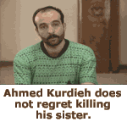
Reuters story
TEHRAN - An Iranian man cut off his seven- year-old daughter's head after suspecting she had been raped by her uncle, the Jomhuri-ye Eslami newspaper said on Sunday.
A post-mortem, however, showed the girl was still a virgin

Slide 38
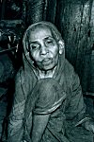
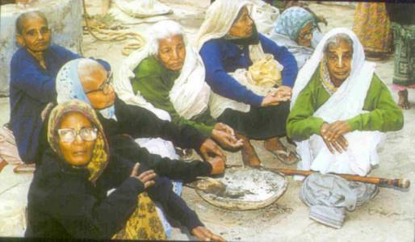
Widowhood in stratified societies

Slide 39
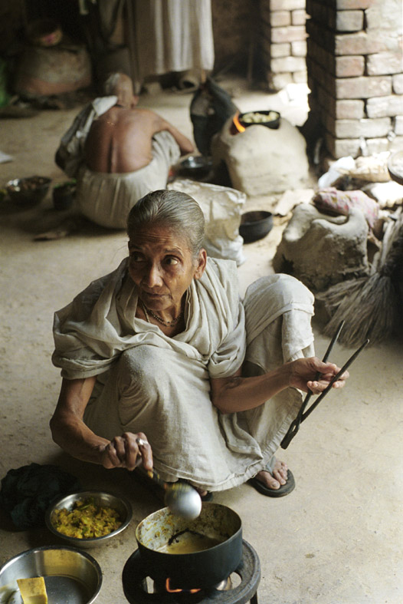
The Aged Woman: Hindu Text and the Widow
• “The widow is more inauspicious than all other inauspicious things. At the sight of a widow, no success can be had in any undertaking; excepting one’s mother, all widows are void of auspiciousness. A wise man should avoid even her blessings like the poison of a snake.”

Slide 40
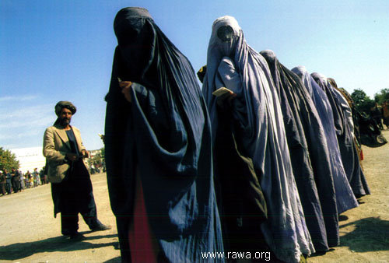
Widows in Afghanistan
After death of husband widows often seen as liability to the family
Often cast adrift with little social economic support
Most illiterate and in current circumstances have difficulty finding food

Slide 41
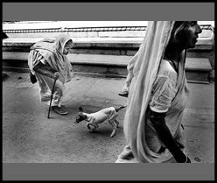
Widows in India
33 million widows in India
Many live in holy cities
Widows are expected to leave the family home
Shave their hair
Wear a white sari as signs of their widowhood

Slide 42
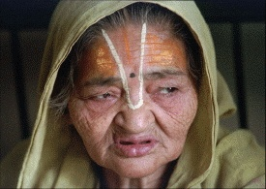
Widowhood in India
Blamed for husband’s death treated shabbily, ostracized, or kicked out
Some murdered over land/money disputes
With no money, her own family often disown her too
“Not allowed” to remarry, men can
Forced into vegetarianism by belief that meat arouses “sexual desire”
In past, widows expected to practice “Sati” –jump onto the funeral pyre of husband (last case 1987)
Poor widows die a social death in India – estimated 33 million widows

Slide 43
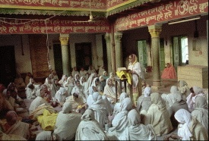
Life in Vrindavan
Refuge for cast-out widows 500 years ago
Some are brought by family on pretext of pilgrimage then left with no one and nothing
5,000 widows gather in morning to pray until nightfall
Each gets $.07 /day and cupful of rice and lentils by temples
Some forced to have sex with landlords, rickshaw drivers, shopkeepers, police, holy men
“Randi” (widow) became synonymous with prostitute
But is only option for independent life

Slide 44
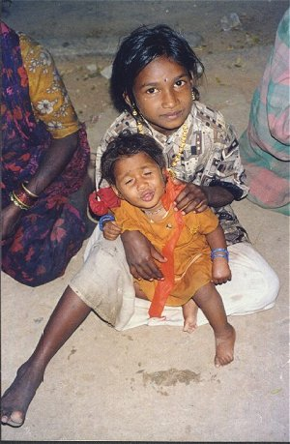
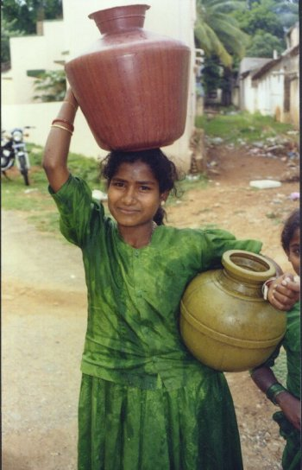
Who wants a girl now? Results of the Marginalization of Women in Stratified Societies

Slide 45
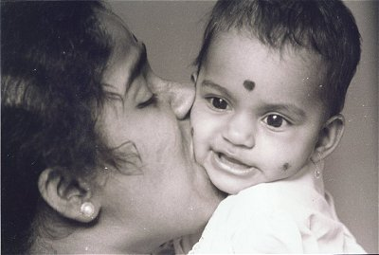
Parental Investment: Preference for Boys
Potential RS for males greater
2:1 sex ratio of boys to girls in upper classes - India
Status of family depends on number of boy children
Because dowries are so expensive
China where ~1 child is allowed – parents prefer boys 7-1 and are using Gen-select kits
Most Chinese infants up for adoption are female

Slide 46
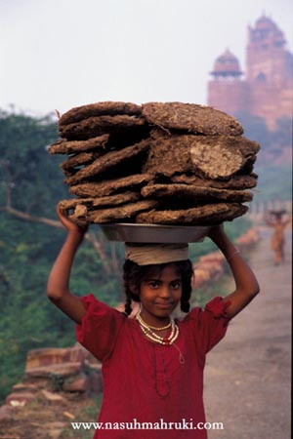
Neglect of Girls
25% of girls die from malnutrition by age 15 – India
Boys much more likely to attend school
Girl infants weaned 2 months earlier than boys -India
Girls often held back from school to help the mother

Slide 47
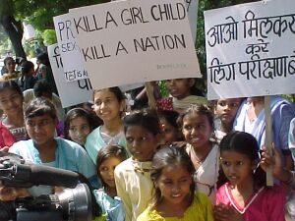
Female biased Infanticide
India - 40-50 million girls have gone 'missing' in India– assumed murdered at birth or within few hours of birth.
Defined as intentional killing of baby girls due to the preference for male babies and the low value associated with the birth of females
Many women report not wanting daughters to go through what they have to when males are more valued in society
Done by mother, birth helper or fathers
Poisoned, stuffed in clay pots, fed salt, strangled, made sick
In one small Indian district it is estimated 540 infants killed per month
In some areas sex ratio 1000 boys for 800 girls – very extreme
Higher probability of death if have one or two elder sisters

Slide 48
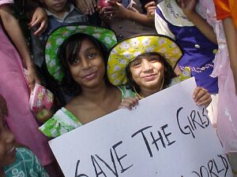
Female biased abortions
Birth of a girl can signal financial ruin
Example a father of three girls (who committed suicide) made only 4000 rupees/year and the groom’s family was demanding 100,000 to marry one daughter
Diagnostic teams with ultrasound scanners advertise “Spend 600 rupees now and save 50,000 rupees later”
A UNICEF report in 1984 on abortions after prenatal sex determination in Bombay stated that 7999 out of 8000 aborted fetuses were females
Pregnancy screening banned –not effective and has increased the cost to families by 10 fold
Estimated 30,000 Korean female fetuses aborted annually
Estimated 1million female fetuses in India each year
Women often blamed for “birth of girl” but it is a medical fact that the sperm decides the sex

Slide 49
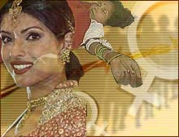
Possible effect
Increase in selective abortion over the last 10 years
Produced highly male biased sex ratio
When these individuals come to the marriage market, there will be many men to fewer women
Might possibly have the effect of lowering demands for dowries ?

Slide 50
US census data also support male child bias (1940-2000)
Families with one girl child as opposed to one boy child were 6% more likely to divorce or separate; 8% for 2/2; 10% for 3/3 and 13% for 4/4 – affects hundreds of thousands of people
If have 3 girls – 4% more likely to try for another child than if have 3 boys
Women who are unmarried at time of ultrasound are 2% more likely to be married if having a boy
Effect is diminishing
Likely because women have greater access to resources

